Slide 1
Mountings & Accessories
Faculty : RAVI PATEL
STUDENT NAME: (1) MAURYA ANANDRAJ J. (2) MAKADIA KULDEEP C.
(3) SHAH UTSAV B.

Slide 2
Mountings
These are different fittings and devices which are necessary for the operation and safety of a boiler.
Normally these device are mounted over boiler shell.

Slide 3
Types of Mountings
Safety Valves
Water Level Indicators
Pressure Gauge
Steam Stop Valve
Feed Check Valve
Blow Off Cock
Attachment For Inspector’s Test Gauge
Man Hole
Mud Holes or Side Holes

Slide 4
Pressure Gauge:-
It is an instrument measure the pressure of stem in boiler.
It is having dial which graduated to read pressure in bar.

Slide 5
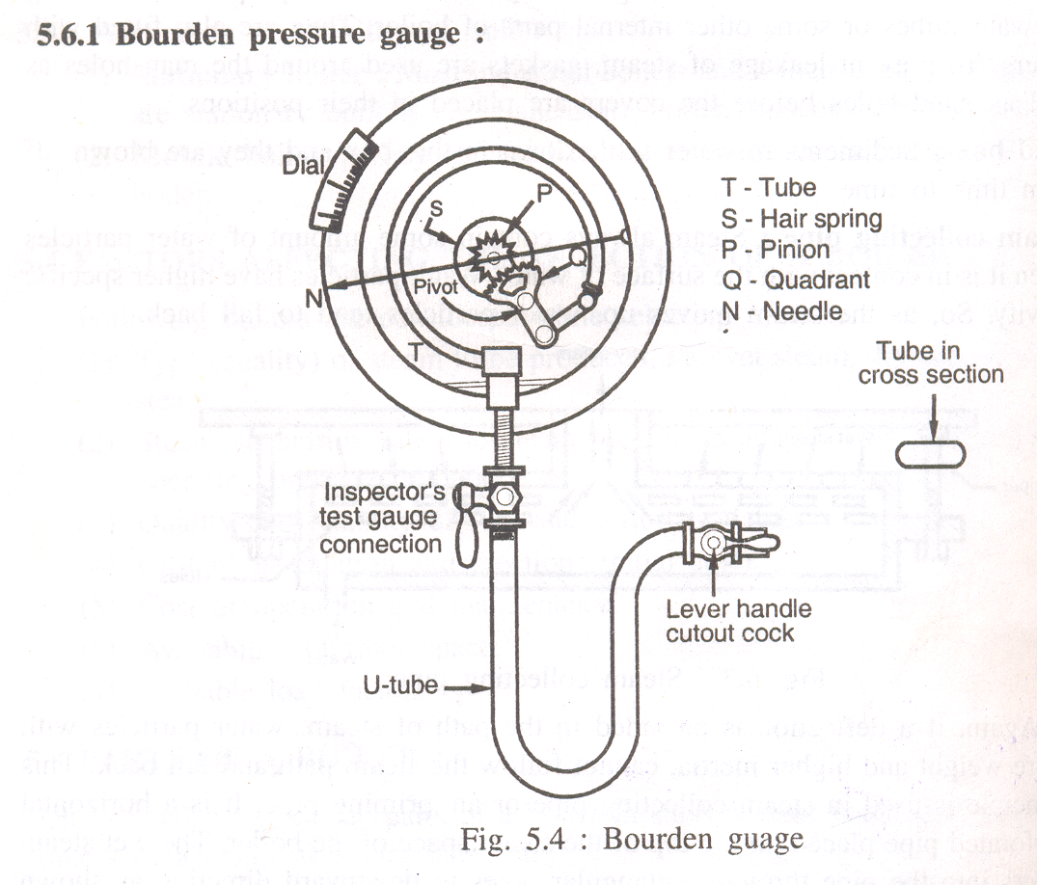

Slide 6
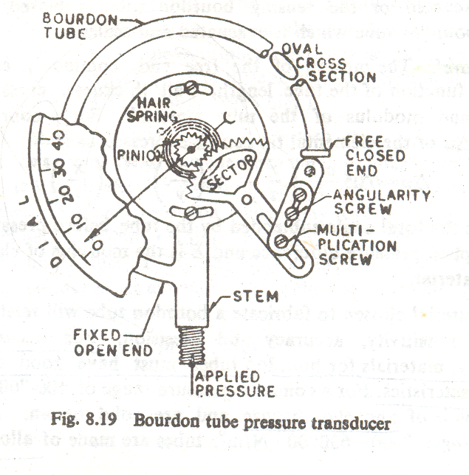

Slide 7
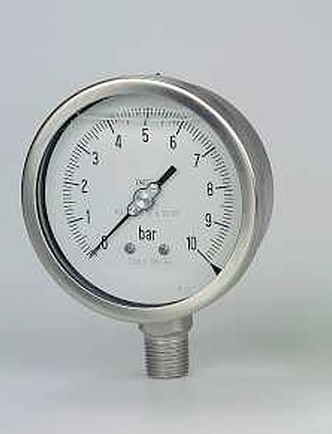

Slide 8
Water Level Indicator:-
Indicate the water level inside the boiler vessel.
It shows level of water in the boiler drum.

Slide 10
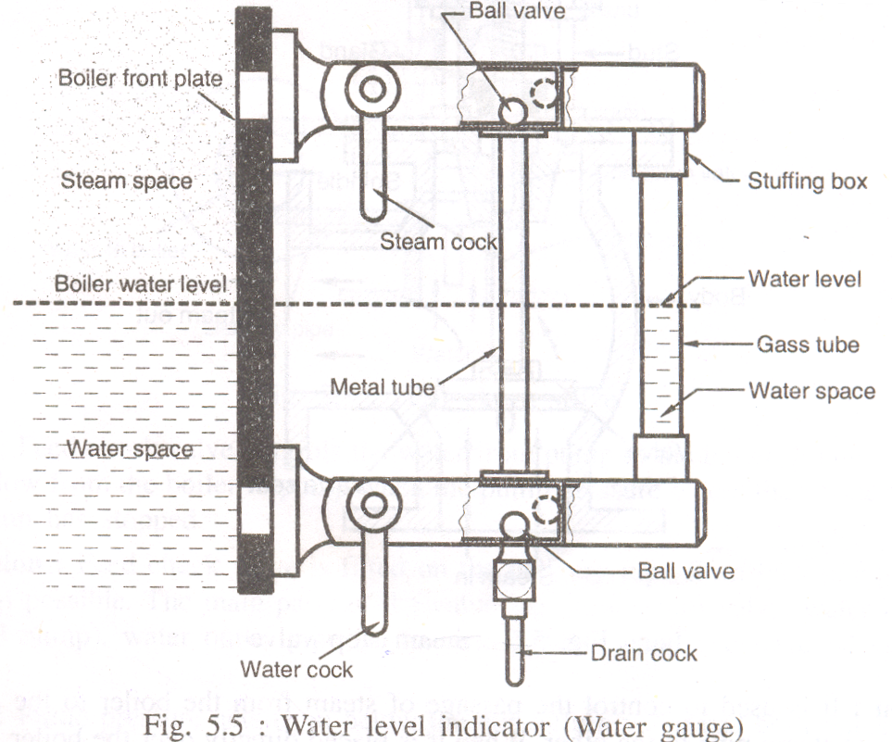

Slide 11
Steam Stop Valve:-
To regulate the flow of steam from boiler to the stem pipe or from one steam pipe to the other.

Slide 13
Feed Check Valve:-
To control the supply of water to the boiler and to prevent the back flow of water from boiler when the feed pump pressure is less than boiler pressure or pump is stopped.

Slide 15
Blow Off Cock:-
To empty the boiler when necessary for cleaning, inspection and repair.
Blow off cock useful to discharge a water which contains mud, sediments etc….

Slide 16
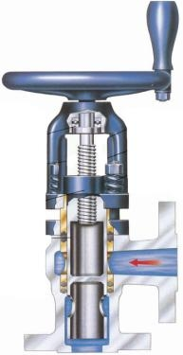

Slide 17
Fusible plug:-
To protect the boiler against damage due to overheating caused by low water level in the boiler.

Slide 19
Safety Valves :-
To release the excess steam when the pressure of steam inside the boiler increase higher than the safe pressure.
Safety valve are used to maintain safe pressure inside the boiler.
Dead weight safety valve
Lever safety valve
Spring loaded safety valve
High steam and low water safety valve

Slide 20
Dead Weight Safety Valve

Slide 21
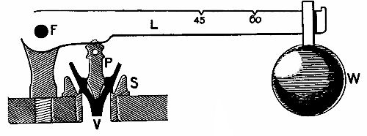
II. Lever Safety Valve

Slide 22
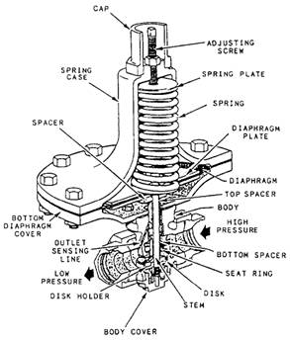
III. Spring Loaded Safety Valve

Slide 23
Accessories
These are auxiliary plants or parts required for steam boilers for proper operation and to increased efficiency of the boiler.

Slide 24
Types of Accessories
Feed pump
Injector
Economizer
Super heater
Steam separator
Air preheater
Draught system

Slide 25
Feed Pump:
To feed the water into the boiler through the feed check valve.
It is used to delivered feed water to the boiler under pressure.
It is a device of boiler used to supplied proper amount of water at least equal to that evaporated in the boiler.
These pumps are classified as;
1. Reciprocating pumps – simplex, duplex, triplex
2. Rotary pump
3. Centrifugal pump

Slide 26
Injector
To feed water into the boiler.
It is commonly employs for vertical and locomotive boiler.
In injector, the water is delivered to the boiler by steam pressure, the kinetic energy of steam is used to increase the pressure and velocity of the feed water.

Slide 27
Economizer
To increase the temperature of the feed water before it enters into the boiler.
It is device in which the waste heat of flues gases is utilized for heating the feed water.
Exhaust steam feed water heater in which the heat from the exhaust steam or steam from boiler is utilized for heating the feed water.

Slide 28
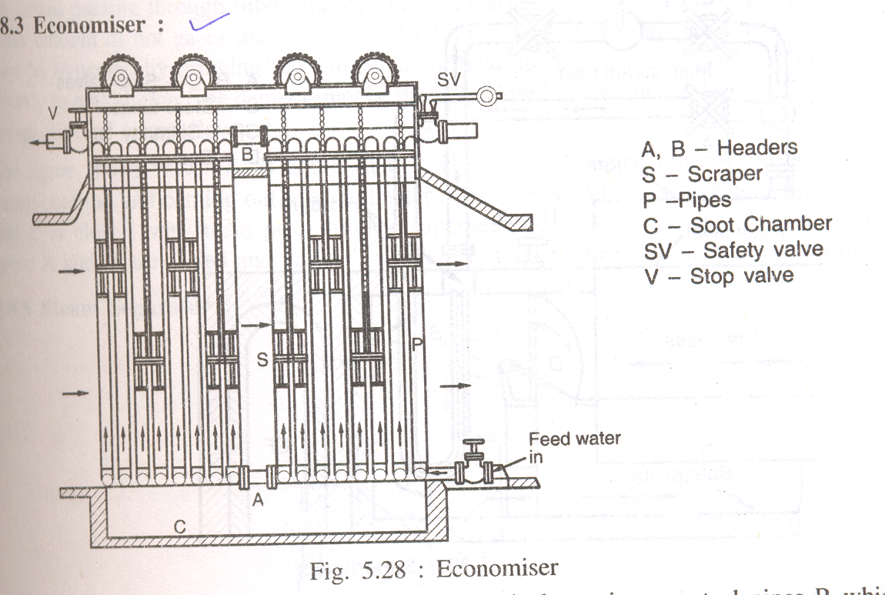

Slide 30
Super Heater
To steam generated above surface of water is always wet.
To increase the temperature of the steam above its saturated point.

Slide 31
Steam Separator
Steam is collected from a boiler may be wet, dry, or superheated, but many case steam become wet due to loss of heat during passing in steam pipe.
To remove the suspended water particles from the steam.

Slide 32
Air Preheater
To increase the temperature of air before it supply to the furnace using heat from flue gases passing through chimney.

Slide 33
Draught System
It is pressure difference required to maintain the constant flow of air to discharge the exhaust gases through the chimney to atmosphere.
Natural draught – chimney
Artificial draught – steam jet and mechanical

Slide 34
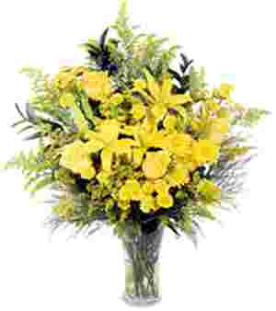
“NO MAN CAN SUCCEED IN A LINE OF ENDEVOR WHICH HE DOES NOT LIKE”
THANK YOU

